Slide 1
DIGGS Data Schema Overview
Incorporating Rigid Inclusions
DIGGS Rigid Inclusions Kickoff

Slide 2
Overview
XML and DIGGS (DIGGS 101)
DIGGS Data Model Overview
  Focused on elements relevant to rigid inclusions

Slide 3
What is DIGGS?
XML Schema documents (XSD), dictionaries defining controlled terms and coordinate systems, and business rules
  The schema is the normative document
    Defines data structure, objects, and properties for transferring geotechnical, geologic, geoenvironmental and hydrologic data
  Enforces rules for data organization
Data is stored/transferred as XML (structured text) instances (files or streaming) that follow DIGGS schema structure

Slide 4
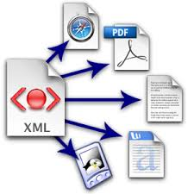
What is XML?
eXtensible Markup Language - a data serialization format used to represent and exchange structured data.
  Human readable, text-based, tree-like structure with user-defined tags - platform independent
  Can accommodate complex data relationships and structures unlike other text-based formats (eg. CSV, JSON)
  Mature, open-source and commercial tools exist for validating, querying, processing, displaying, and transforming XML data.
Notes:
Especially well suited for standards (like DIGGS) that require strict data validation

Slide 5
What is DIGGS?
DIGGS is based on Geography Markup Language (GML), a specialized XML vocabulary for storing and transferring spatial data
  Geologic/geotechnical data is inherently spatial
  GML is an international standard (ISO/OGC)
  GML has standardized Feature and data types for geometries, coordinate reference systems, coverages, etc.
  Readily adopted for display andmanipulation of data over the Internet using web map services
Notes:
(GML) is the XML grammar defined by the Open Geospatial Consortium (OGC) to express geographical features. GML serves as a modeling language for geographic systems as well as an open interchange format for geographic transactions on the Internet. Key to GML's utility is its ability to integrate all forms of geographic information, including not only conventional "vector" or discrete objects, but coverages (see also GMLJP2) and sensor data.

Slide 6
What is DIGGS?
DIGGS defines a structure for describing real-world objects and activities common to geotechnical and geoenvironmental practice, and how they inter-relate
DIGGS is extensible
  Flexible framework for adding objects not already included in the standard
  Able to reference non-text data (photos, docs, etc.) as part of the transfer standard
DIGGS does not dictate practice
  Rather, it is a framework that allows test specifications, procedures, etc. to be documented as part of the data transfer/storage protocol.
DIGGS is profilable
  Can restrict the schema to enforce business rules for specific use cases

Slide 7
DIGGS 101
Diggs inherits its overall structure from its parent types
XML
GML
Diggs

Slide 8
DIGGS 101
What does a DIGGS instance look like?
  A collection of ELEMENTS (tagged text) enclosed within a root element
  An element can have zero or multiple attributes
  The value of an element can be text, or other elements
  Elements with a text value are of simpleType
  Elements that contain elements are of complexType
<name attribute=“attribute value”>value</name>
<Diggs>
<samplingFeature>
<Borehole gml:id=“abc”>
<gml:name>Borehole 1</gml:name>
</Borehole>
</samplingFeature>
</Diggs>

Slide 9
DIGGS 101
What is the DIGGS Schema?
  XML file that describes how DIGGS “instances” (data files or streams) are structured
  Defines elements that are allowed
  Defines element types and value restrictions, defaults, fixed values, etc.
  Defines how elements are composited
    Sequence: (elements are required to occur in a specific order
    Choice: (allows one of a group of elements to occur within a sequence
  Defines element substitutions
  Defines namespaces used (vocabularies allowed)

Slide 10
DIGGS 101
As DIGGS relies on GML, it conforms to GML’s required nomenclature, definitions, conventions
GML defines two types of XML elements
  Object
    An element of complexType with optional “identity” that is derived (inherits) from a base “abstract” GML type (UpperCamelCase)
  Property
    An element of simple type or ”propertyType” that is contained within an object (lowerCamelCase)
Simple example: Road is an object; gml:name, numLanes and pavementType are properties of the road object
  <Road gml:id=“r1”>
    <gml:name>Main St.</gml:name>
    <numLanes>4</numLanes>
    <pavementType>concrete</pavementType>
  </Road>

Slide 11
DIGGS 101
DIGGS base types
DIGGS Objects
  Derive from gml objects but may contain geometry properties
  Contain the following optional properties
    gml:id (attribute; mandatory in some cases)
    gml:description
    gml:identifier
    gml:name
    status (release status and/or quality control info for the object)
    remark
Some DIGGS object variants require gml:name or may remove all optional elements except for gml:id.
Notes:
The gml:id is used for referencing objects to each other. For example, a borehole that was created as part of a project will reference the id of the project in the borehole’s projectRef property. This is how major associations are made, rather than nesting a borehole within the project object in a hierarchical form.

Slide 12
DIGGS 101
DIGGS features
  "high level" DIGGS objects - that tend to be referenced outside of the XML hierarchy
    Mandatory gml:id
    Often contain geometry objects
  Plus optional:
    gml:internaldentifier
    associatedFile
    role
Some DIGGS feature variants require gml:name or may remove some optional elements

Slide 13
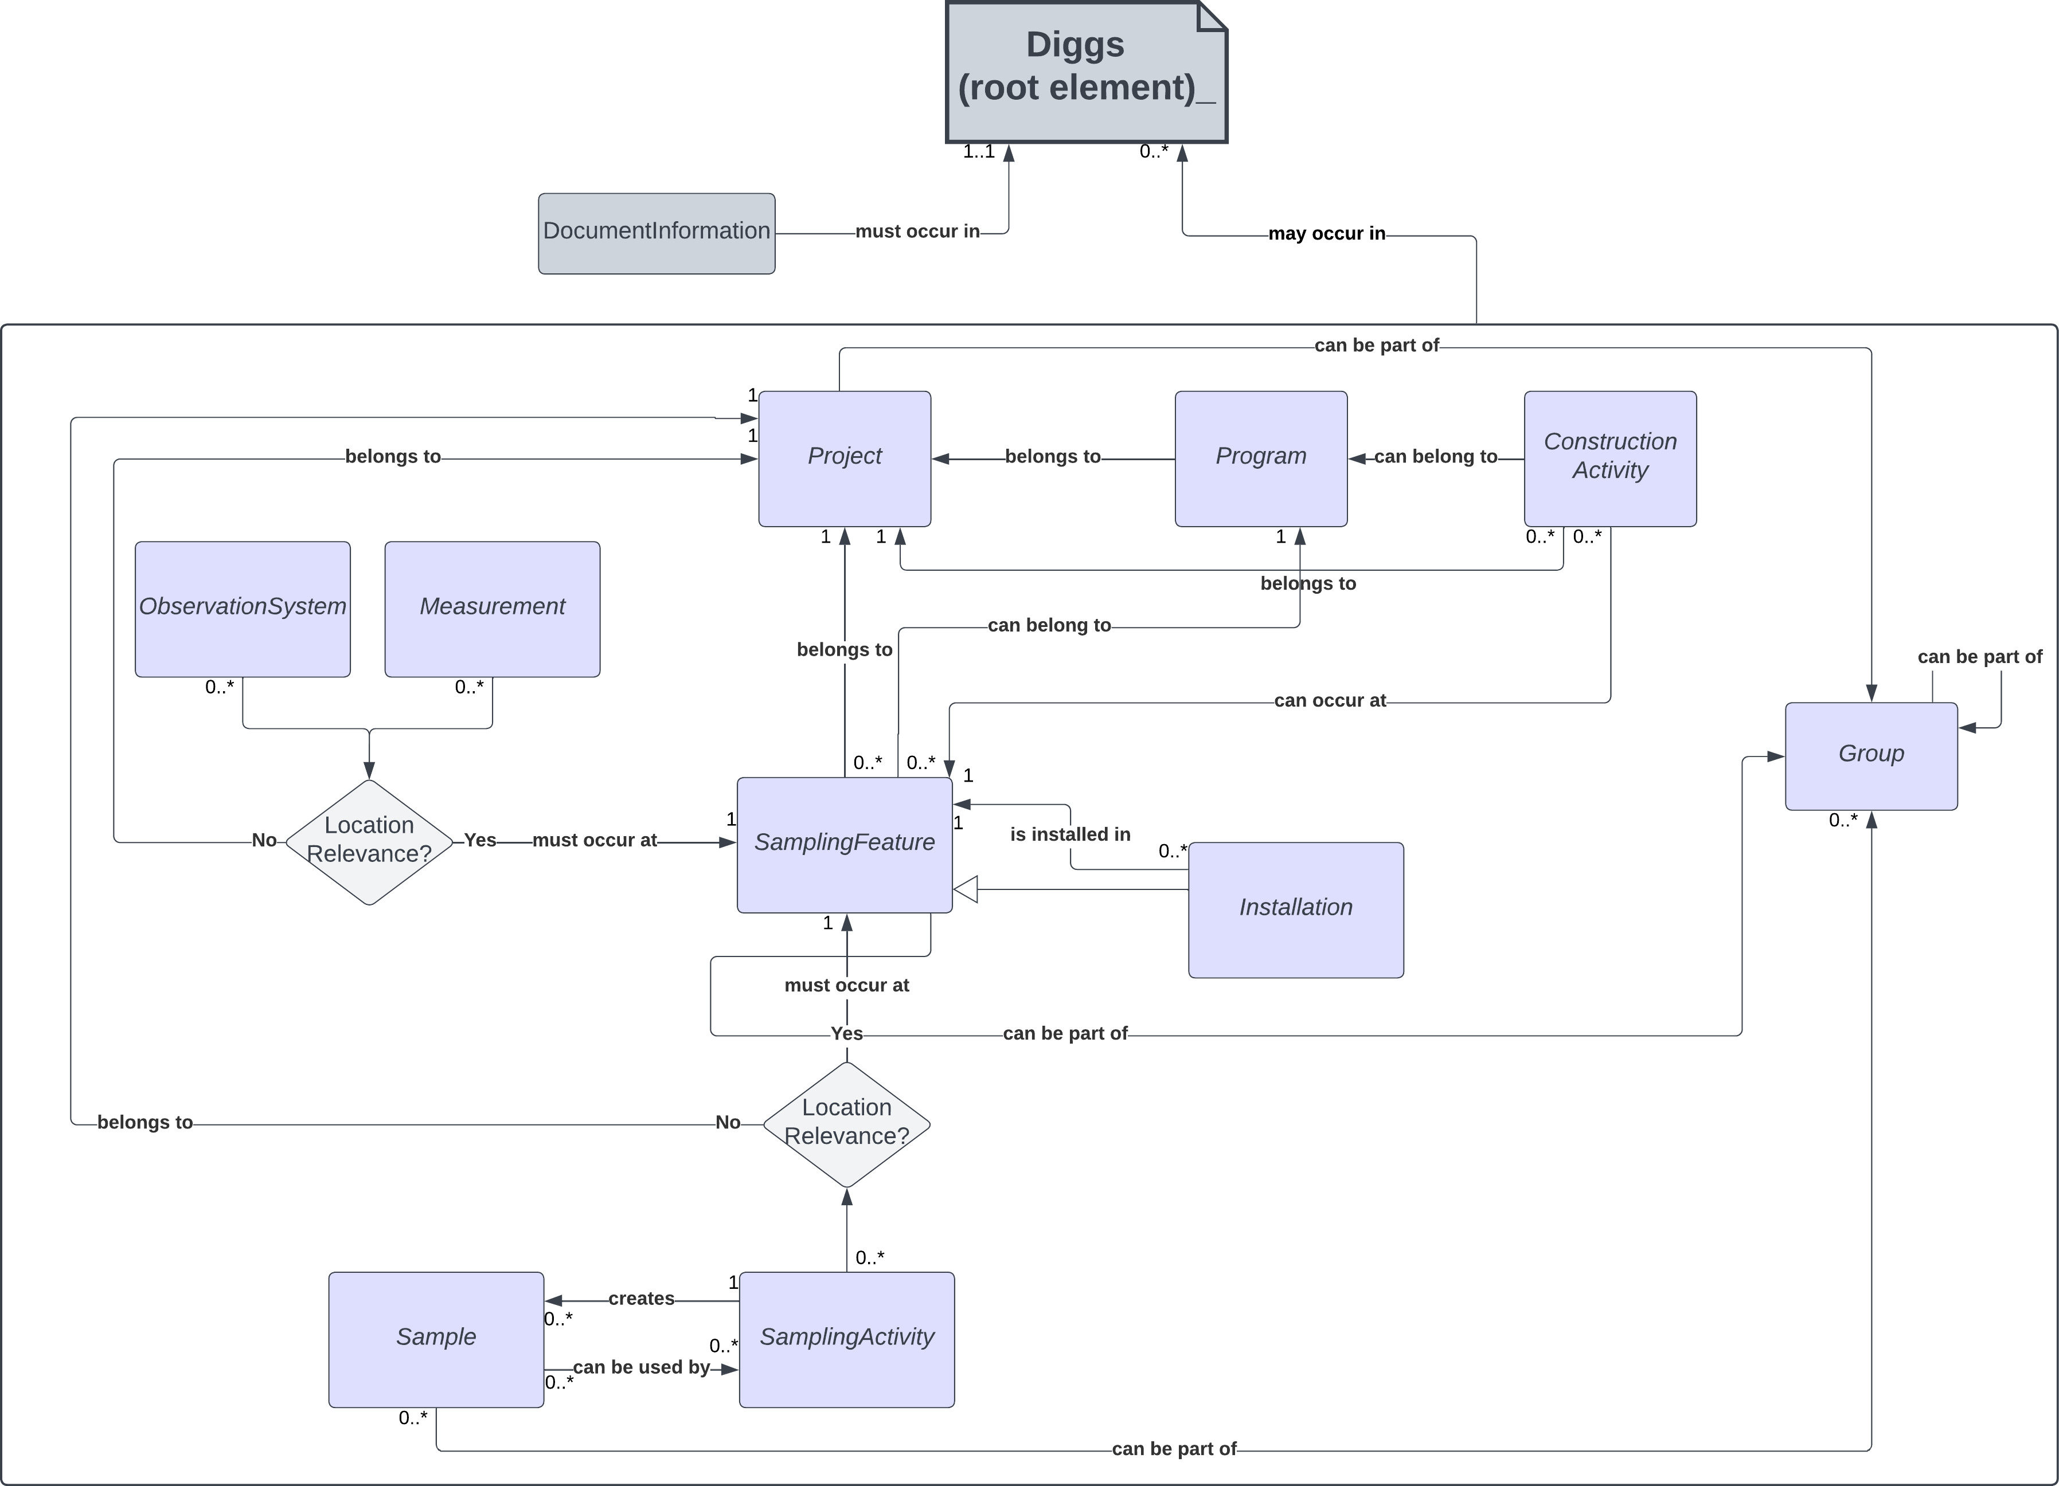
DIGGS Data Model
Notes:
A DIGGS instance consists of a number of modular component objects that are nested within the properties above under a single Diggs object. A DIGGS instance is only required to have the documentInformation property, which provides information about that particular data transmission and optionally a history of past transmission versions. All other properties are optional. This allows for sharing of component pieces of a domain of information. For example, a DIGGS file may contain only sample information for transmission to a laboratory for analysis, whereas the returning DIGGS transmission from a laboratory may contain only the relevant measurement results.

Slide 14
DIGGS Data Model
Project
A collection of sampling features, activities, samples, observation systems and measurements that form a business activity.
All classes of DIGGS objects must belong to a project
Currently only one (generic) concrete Project object exists
Contains optional location properties and those associated with a business activity – eg. purpose, events, contracts
Notes:
A DIGGS instance consists of a number of modular component objects that are nested within the properties above under a single Diggs object. A DIGGS instance is only required to have the documentInformation property, which provides information about that particular data transmission and optionally a history of past transmission versions. All other properties are optional. This allows for sharing of component pieces of a domain of information. For example, a DIGGS file may contain only sample information for transmission to a laboratory for analysis, whereas the returning DIGGS transmission from a laboratory may contain only the relevant measurement results.

Slide 15
DIGGS Data Model
Sampling Feature
A physical object or location through which we observe or measure properties of the earth, or perform some type of activity. It serves to define the dimensionality, extent, and local spatial reference system for zones where observations or activities take place.
Notes:
A DIGGS instance consists of a number of modular component objects that are nested within the properties above under a single Diggs object. A DIGGS instance is only required to have the documentInformation property, which provides information about that particular data transmission and optionally a history of past transmission versions. All other properties are optional. This allows for sharing of component pieces of a domain of information. For example, a DIGGS file may contain only sample information for transmission to a laboratory for analysis, whereas the returning DIGGS transmission from a laboratory may contain only the relevant measurement results.

Slide 16
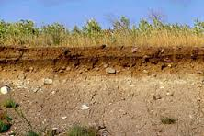
We observe/measure properties of the earth via a sampling feature
TrenchWall
Borehole

Slide 17
Diggs Sampling Features (v. 3.0)
0D (modeled by a GML Point)
Station
1D (modeled by a GML LineString)
Borehole
Sounding
Transect
TrialPit (AGS Legacy)
GP_Trackline
GroutTrenchCutoffWall
Installations
  Well
  ConcretePile
  SteelHPile
  SteelPipePile
  TimberPile
2D (modeled by a GML Polygon)
GP_ArealSurvey
PlanarSamplingFeature
TrenchWall
3D (modeled by a GML Solid)
VolumetricSamplingFeature

Slide 18
Sampling Features define the geographic and geometric context of the data we obtain
1D (Linear) Sampling Features (Borehole)
  referencePoint (GML point)
    Usually at one end of the borehole path
      Eg. top of hole at land surface, rig table, etc.)
    Represented in 3 dimensions (x, y, z)
    Useful for map view representations
(x₁,y₁,z₁)
<referencePoint>
<PointLocation gml:id="pl-B-01" srsDimension="3"
srsName="https://www.opengis.net/def/crs-compound?1=http://www.opengis.net/def/crs/EPSG/0/4326%26
2=http://www.opengis.net/def/crs/EPSG/0/6360" uomLabels="dega dega ft">
<gml:pos>30.429139 -91.212861 19.00</gml:pos>
</PointLocation>
</referencePoint>

Slide 19
Sampling Features define the geographic and geometric context of the data we obtain
1D (Linear) Sampling Feature Geometry
  centerLine (GML LineString)
    A connected set of vertices that define the sampling feature’s trajectory
    Represented in 3 dimensions
    A linear sampling feature can have more than one centerLine property
(x₁,y₁,z₁)
(x₁,y₁,z₂)
<centerLine>
<LinearExtent gml:id="cl-B-01" srsDimension="3"
srsName="https://www.opengis.net/def/crs-compound?1=http://www.opengis.net/def/crs/EPSG/0/4326%26
2=http://www.opengis.net/def/crs/EPSG/0/6360" uomLabels="dega dega ft">
<gml:posList>30.429139 -91.212861 19.00 30.429139 -91.212861 -141</gml:posList>
</LinearExtent>
</centerLine>

Slide 20
Can DIGGS represent inclined or deviated sampling features?
YES!! (it’s all in the gml:posList property)
(x₁,y₁,z₁)
(x₁,y₁,z₁)
(x₁,y₁,z₁)
(x₂,y₂,z₂)
(x₃,y₃,z₃)
(x₄,y₄,z₄)
<gml:posList>x1 y1 z1 x2 y2 z2 x3 y3 z3 x4 y4 z4</gml:posList>
(x₂,y₂,z₂)
<gml:posList>x1 y1 z1 x2 y2 z2</gml:posList>
(x₁,y₁,z₂)
<gml:posList>x1 y1 z1 x1 y1 z2</gml:posList>

Slide 21
How do we represent the position of samples/measurements within a linear sampling feature?
(x₁,y₁,z₁)
Linear referencing
Measured
Depth = 5 ft
<linearReferencing>
<LinearSpatialReferenceSystem gml:id="cptsr1">
<gml:identifier codeSpace=”LADOT"> LADOT:cptsr1</gml:identifier>
<glr:linearElement xlink:href="#ls1"/>
<lrm>
  <LinearReferencingMethod gml:id="md_ft">
  <gml:description>
  Absolute measured depth from top of borehole or sounding in feet.
  Measurements are cumulative 3D distance along the borehole/sounding centerline
  from the first coordinate (typically top of hole or rig datum) proceeding downward through
  the hole. Suitable for vertical, slanted, and deviated boreholes and soundings.
  </gml:description>
  <.gml:identifier codeSpace="https://diggsml.org/def/authorities.xml#DIGGS">
  https://diggsml.org/def/crs/DIGGS/0.1/lrm.xml#md_ft</gml:identifier>
  <name>trueFootage</name>
  <type>absolute</type>
  <units>ft</units>
  <positiveDirection>downward</positiveDirection>
  </LinearReferencingMethod>
</lrm>
</LinearSpatialReferenceSystem>
</linearReferencing>
Measured
Depth = 8-9 ft
(x₁,y₁,z₂)
<sampleLocation>
<PointLocation gml:id="pt1-2" srsName="#cptsr1" srsDimension="1">
<gml:pos>5</gml:pos>
</PointLocation>
</sampleLocation>
<sampleLocation>
<LinearExtent gml:id=”cr1-2" srsName="#cptsr1" srsDimension="1">
<gml:posList>8 9</gml:posList>
</LinearExtent>
</sampleLocation>

Slide 22
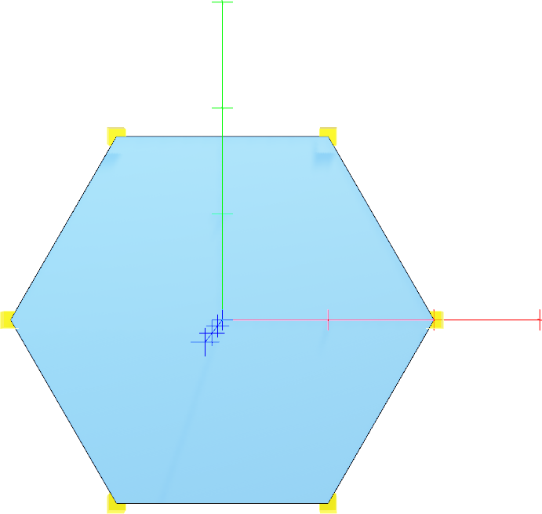
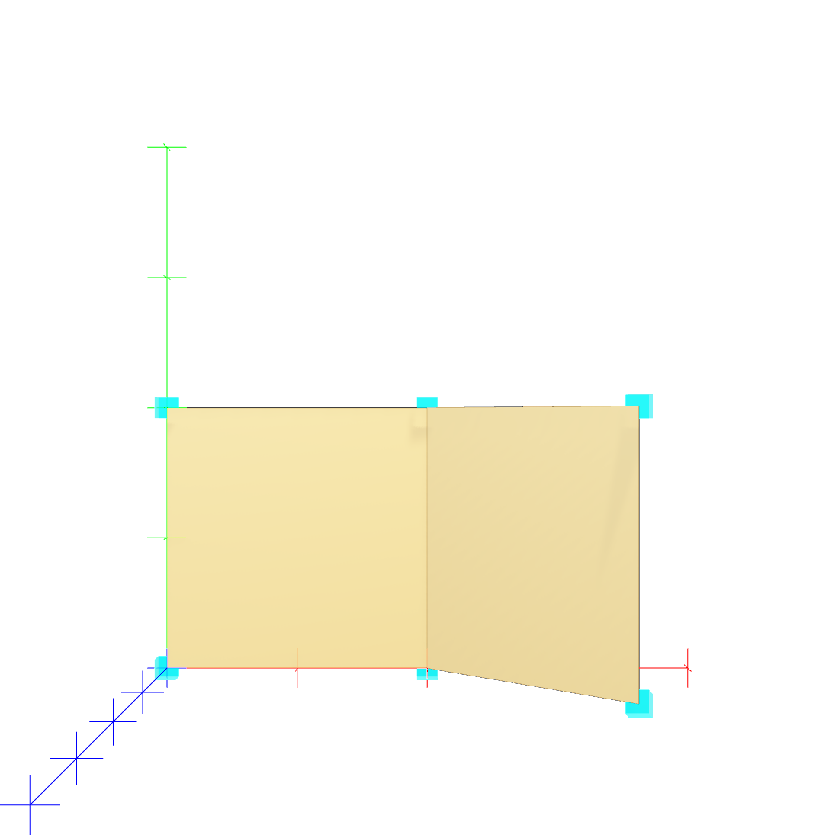
Geometry Definitions for 2D and 3D Sampling Features
2D
  referencePoint (PointLocation as before)
  featureExtent (PlanarSurface, MultiPlanarSurface)
PlanarSurface
Multi-PlanarSurface
Can define coordinates in spatial CRS or in local
Cartesian SRS with spatially located axis-origin
and axis-orientations

Slide 23
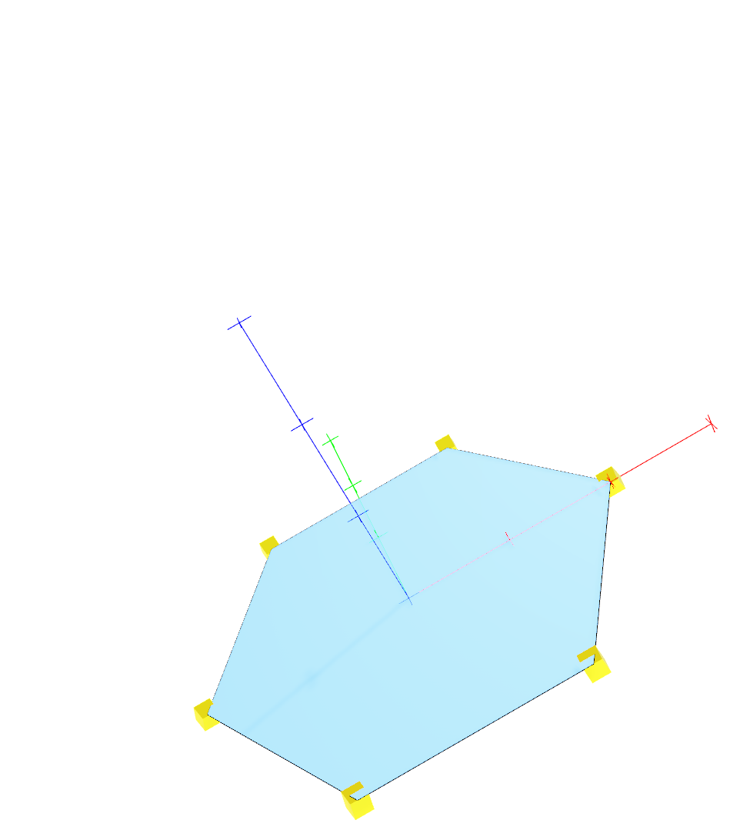
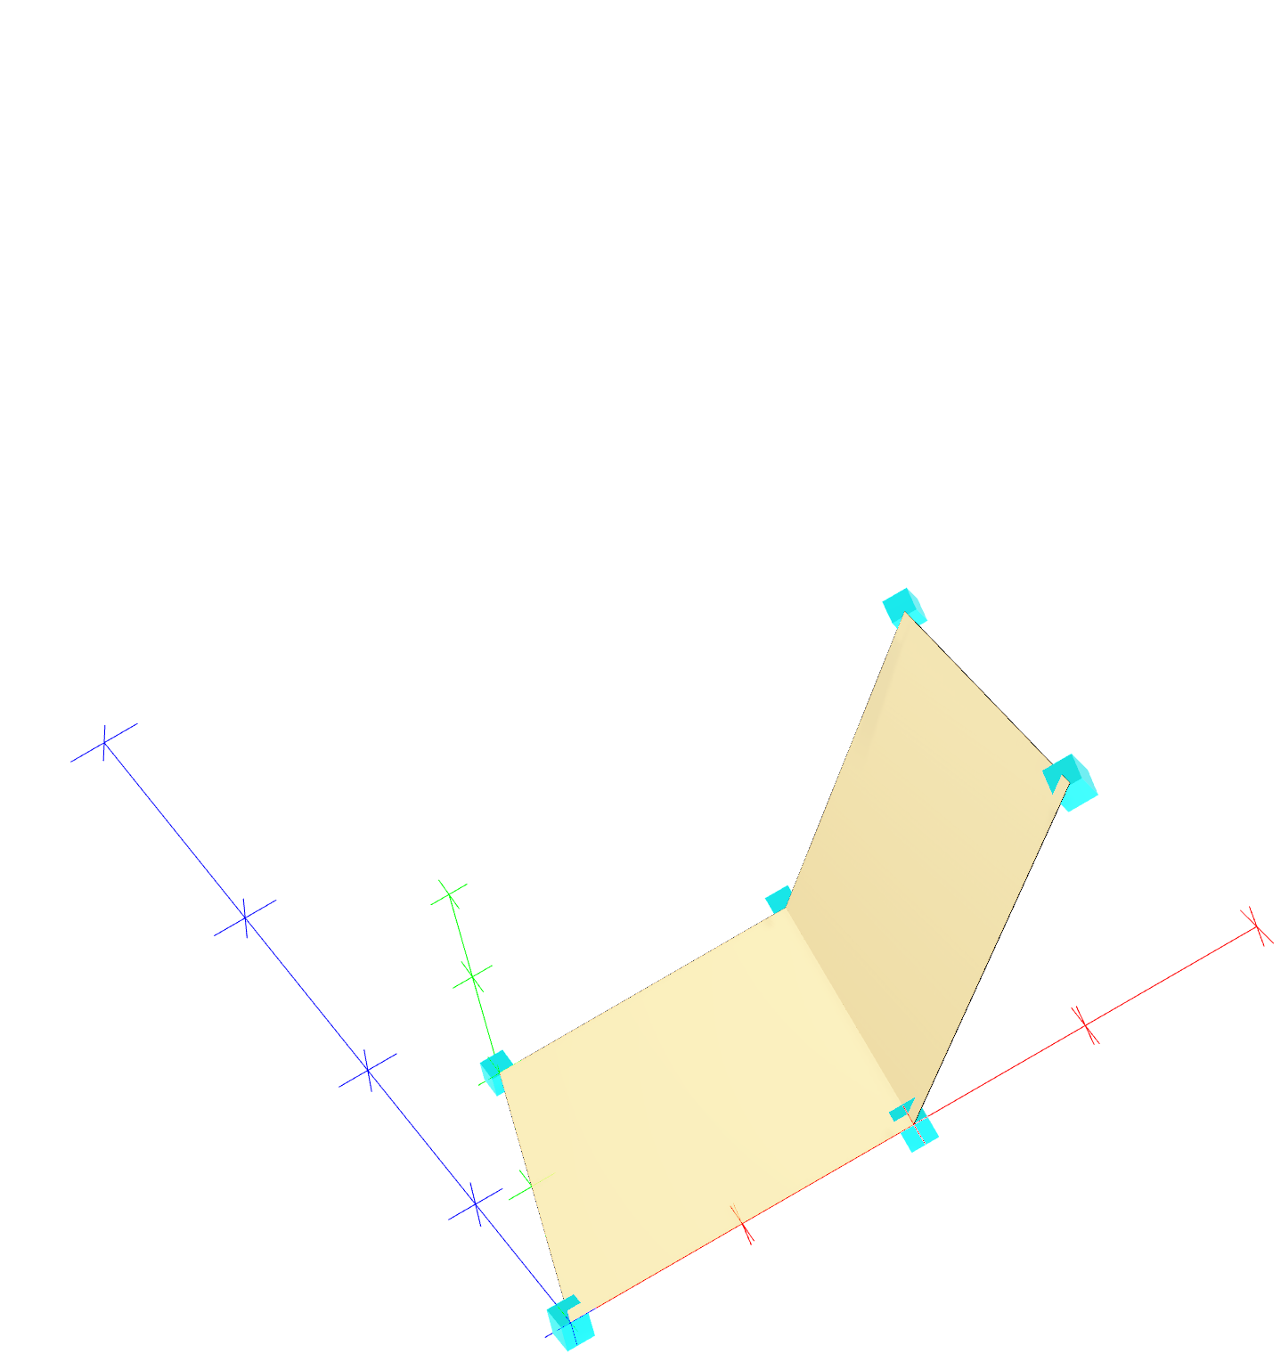
Geometry Definitions for 2D and 3D Sampling Features
2D
  referencePoint (PointLocation as before)
  featureExtent (PlanarSurface, MultiPlanarSurface)
PlanarSurface
Multi-PlanarSurface
Can define coordinates in spatial CRS or in local
Cartesian SRS with spatially located axis-origin
and axis-orientations

Slide 24
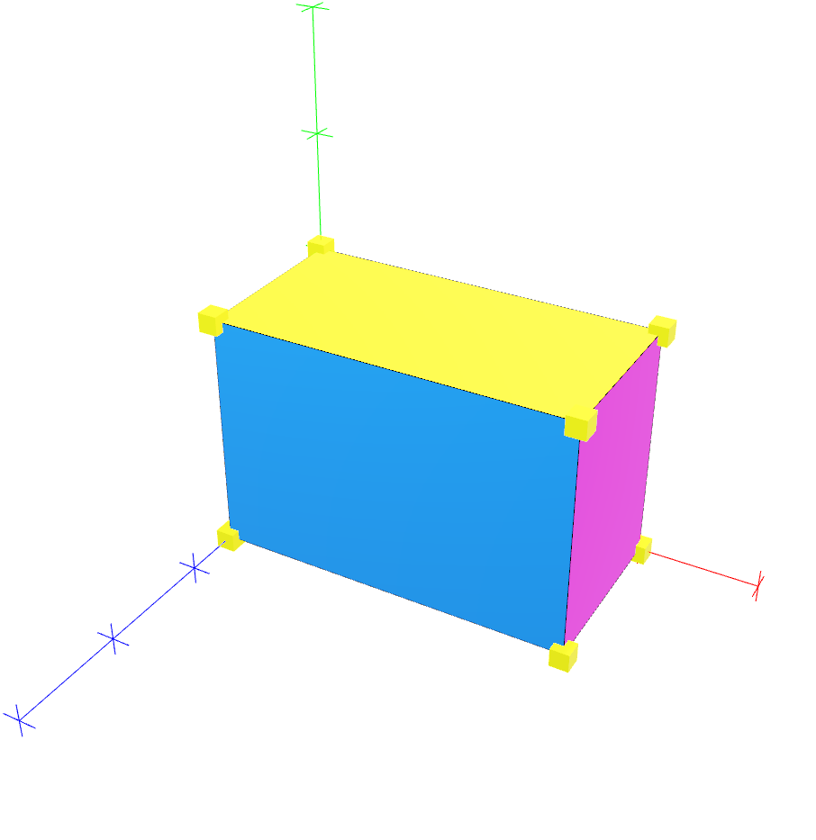
Geometry Definitions for 2D and 3D Sampling Features
2D
  referencePoint (PointLocation as before)
  featureExtent (Solid)
Solid
Each face is defined as a 2D surface (Shell)

Slide 25
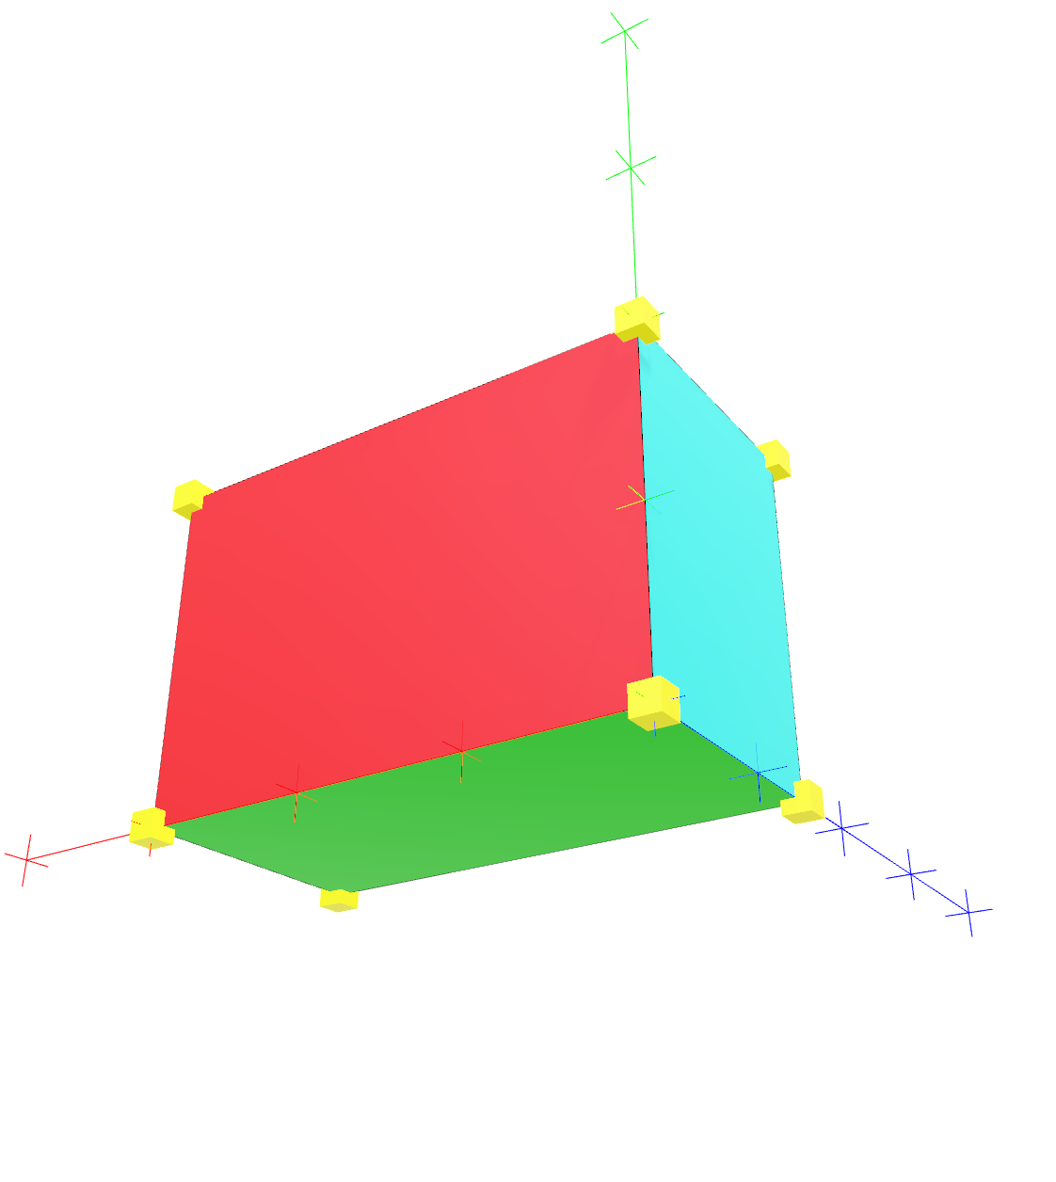
Geometry Definitions for 2D and 3D Sampling Features
2D
  referencePoint (PointLocation as before)
  featureExtent (Solid)
Solid
Each face is defined as a 2D surface (Shell)

Slide 26
What SF’s might be required for R-I?
R-I element options:
  Specialized linear SF with R-I construction properties contained within the SF (eg. Borehole)
  Borehole with ConstructionActivity within the borehole. (eg. grouting)
  As Installation in a Borehole (eg. pile)
Load Transfer Platform options
  Is a SF describing LTP necessary?
  Pseudo-1D, 2D or 3D SF?
Specialized R-I collection (as a single SF) or SF group?
  To tie RI and LTP elementstogether cleanly (eg. GP_Multitrack)

Slide 27
DIGGS Data Model
Observations
……
Notes:
A DIGGS instance consists of a number of modular component objects that are nested within the properties above under a single Diggs object. A DIGGS instance is only required to have the documentInformation property, which provides information about that particular data transmission and optionally a history of past transmission versions. All other properties are optional. This allows for sharing of component pieces of a domain of information. For example, a DIGGS file may contain only sample information for transmission to a laboratory for analysis, whereas the returning DIGGS transmission from a laboratory may contain only the relevant measurement results.

Slide 28

DIGGS Data Model
Observation (ISO 19156)
  An observation is an act associated with a discrete time instant or period through which a number, term or other symbol is assigned to a characteristic. This act involves application of a specified procedure, such as a sensor, instrument, algorithm or process chain. The procedure may be applied in-situ, remotely, or ex-situ with respect to the sampling location. The result of an observation is an estimate of the value of a property of some feature; an observation is a property-value-provider for a feature-of-interest. Use of a common model allows observation data using different procedures to be combined unambiguously

Slide 29
DIGGS Data Model
DIGGS considers two types of Observations:
  Observation Systems
  Measurements
DIGGS Observation Systems
  Collection of spatially associated observations with the same set of property-value results
  Results derives from direct human interaction, judgment or analysis.
    Typically subjective; often qualitative, category based
  Types of DIGGS observations:
    Descriptive (eg. color, soil classification, field observations)
    Interpretive/Generalization/Modeled
      Genesis (eg. alluvium, beach sand)
      Formation assignment (time or spatial ordering)
      Modeled data (eg. velocity layering)

Slide 30
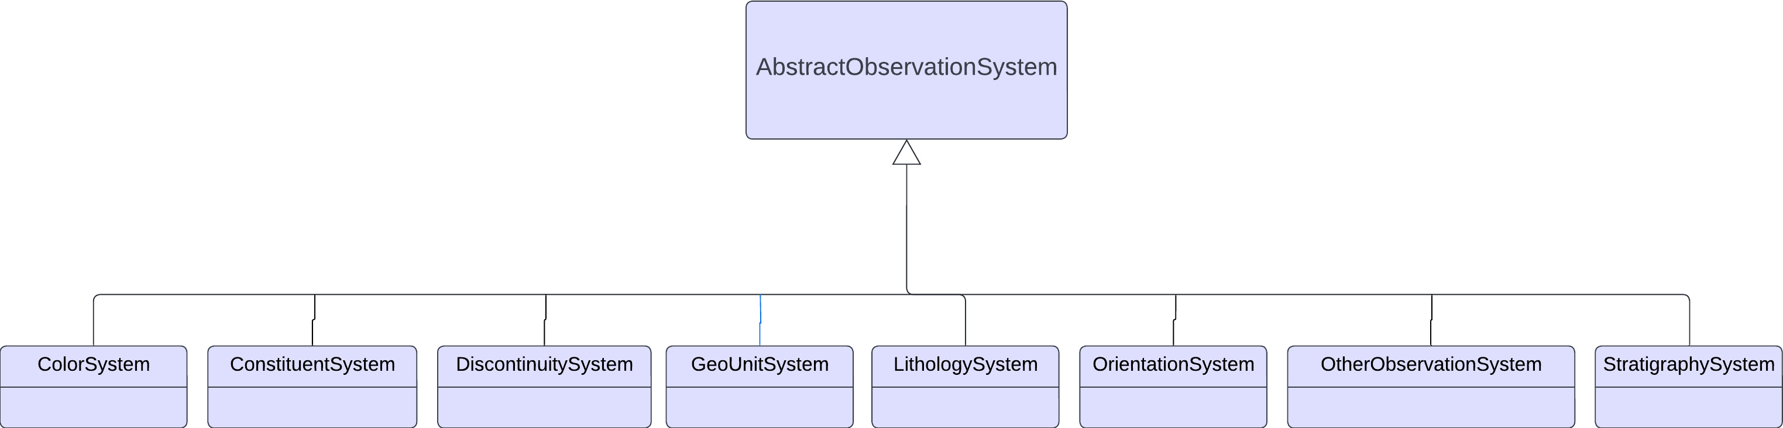
DIGGS Data Model
Observation systems are include a collection of “observation” objects where each object contains properties that are observed at a specific location.
The observation procedure is specified within the observation system

Slide 31
ObservationSystems contain one or more Observation objects, each assigned to a region of a sampling feature
LithologySystem
StratigraphySystem
ColorSystem
CL
10YR 4/2
Other ObservationSystems
ConstituentSystem
DiscontinuitySystem
GeoUnitSystem
OrientationSystem
OtherDescriptionSystem
Fill
10YR 3/1
SM
7.5YR 4/3
Alluvium
5Y 6/3
GP
10YR 6/2
TrenchWall
GC
Briggs
Fm.
Borehole

Slide 32
DIGGS Data Model
Measurement
  Results (property-value pairs) derive principally from the use of testing equipment and/or sensors.
    Typically objective with high precision results as long as procedures are followed and equipment is operating appropriately; results are usually numeric values, although category assignments can be calculated numeric results.
  Types of DIGGS measurements:
    Laboratory tests on samples (eg. Particle size, Atterberg limits)
    In-situ tests (CPT, SPT, DMT, geophysical tests)
    Monitoring Activities (eg. piezometer, pumping tests)

Slide 33
Measurements
Four measurement features in DIGGS
  Test – measurements over a spatial domain (lab and in-situ tests)
  Monitor – measurements over a temporal domain (monitoring activities)
  MaterialTest – measurement on a physical sample that has no location relevance (eg. lab created or aggregated sample)
  MeasurementWhileDrilling – time or depth indexed observations of drilling parameters while a borehole is being constructed
All measurements are structured very similarly
Results are reported in a self-describing fashion for extensibility and to support the wide range of measurement results and procedures used in geotechnical and geoenvironmental studies.
Measurements do NOT carry RAW or solely procedural data (eg. tare weights, machine voltages, container ID’s)

Slide 34
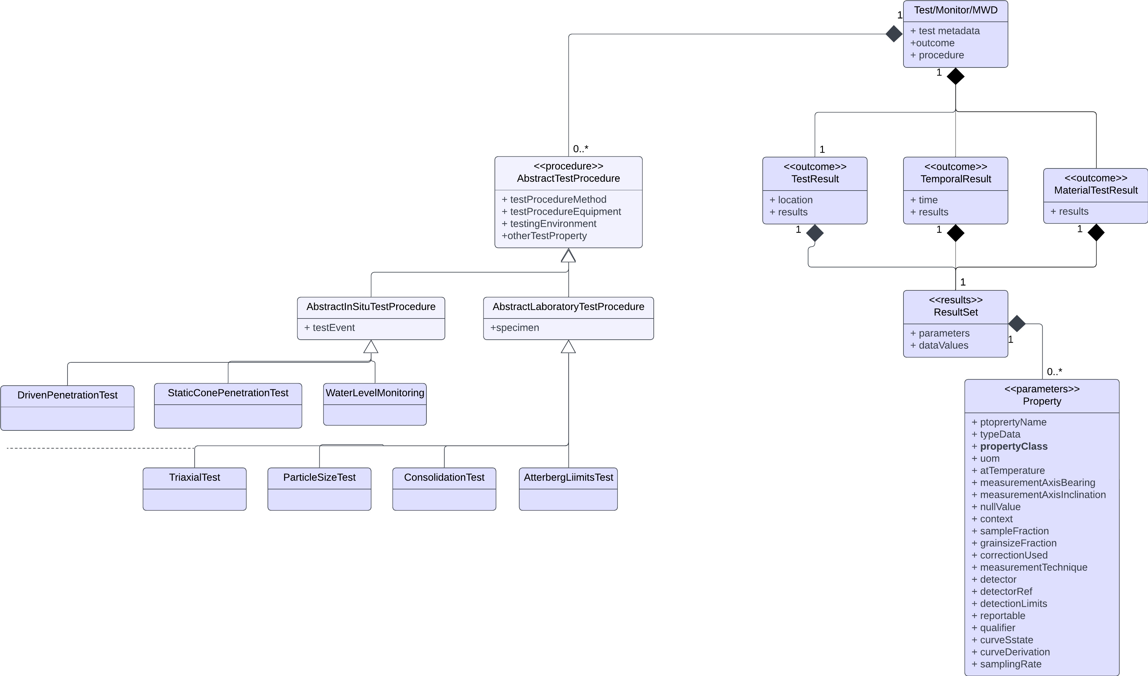
Structure of a Measurement
Result encoding derives from GML coverage
Procedures are specialized according to the specific of the test procedure. They are explicitly defined and may themselves contain observations made to derive the ultimate property-value results of the measurement

Slide 35
<outcome>
<TestResult gml:id="altr1">
<location>
<PointLocation gml:id="pl2" srsDimension="1" srsName="#sr123">
<gml:pos>32</gml:pos>
</PointLocation>
</location>
<results>
<ResultSet>
<parameters>
<PropertyParameters gml:id="pp">
<properties>
<Property index="1">
<propertyName>LL</propertyName>
<typeData>integer</typeData>
<propertyClass codeSpace=“https://diggsml.org/def/codes/DIGGS/0.1/properties.xml#liquid_limit”>Liquid Limit</propertyClass>
</Property>
<Property index="2">
<propertyName>PL</propertyName>
<typeData>integer</typeData>
<propertyClass codeSpace="https://diggsml.org/def/codes/DIGGS/0.1/properties.xml#plastic_limit"> ">Plastic Limit</propertyClass>
</Property>
<Property index="3">
<propertyName>PI</propertyName>
<typeData>integer</typeData>
<propertyClass codeSpace="https://diggsml.org/def/codes/DIGGS/0.1/properties.xml#plasticity_index">Plasticity Index</propertyClass>
</Property>
<Property index="4">
<propertyName>Symbol from plasticity chart</propertyName>
<typeData>string</typeData>
<propertyClass codeSpace="https://diggsml.org/def/codes/DIGGS/0.1/properties.xml#uscs_symbol_425”>USCS Symbol</propertyClass>
</Property>
<Property index=”5">
<propertyName>LI</propertyName>
<typeData>double</typeData>
<propertyClass codeSpace="https://diggsml.org/def/codes/DIGGS/0.1/properties.xml#liquidity_index">Liquidity Index</propertyClass>
</Property>
</properties>
</PropertyParameters>
</parameters>
<dataValues>
25,12,13,"CL",0.66
</dataValues
</ResultSet>
</results>
</TestResult>
</outcome>

Slide 36
Application of observationSystems/measurements to R-I
Pre-installatio
  Soil descriptions taken during drilling (LithologyObservationSystem)
  In-situ measurements during drilling (Test)
  Laboratory tests on samples collected from drilling (Test)
  Lab tests on inclusion materials (aggregate, cement, etc., MaterialTest)
Post-installation
  Post-installation in-situ tests (eg/ load tests, Test/Monitor)
  Post-installation tests on emplaced materials (Test)

Slide 37
DIGGS Data Model
Construction Activity
An activity intended to improve or alter ground conditions.
Notes:
A DIGGS instance consists of a number of modular component objects that are nested within the properties above under a single Diggs object. A DIGGS instance is only required to have the documentInformation property, which provides information about that particular data transmission and optionally a history of past transmission versions. All other properties are optional. This allows for sharing of component pieces of a domain of information. For example, a DIGGS file may contain only sample information for transmission to a laboratory for analysis, whereas the returning DIGGS transmission from a laboratory may contain only the relevant measurement results.

Slide 38
ConstructionActivity Components
Base type:
  References project, samplingFeature
  Construction method(s), event(s), equipment
Concrete elements
  Activity metadata
  Time-series observations during construction

Slide 39
Application of constructionActivity to R-I
Time-series or other data recorded during construction
Construction metadata (method descriptions, equipment, etc.)

Slide 40
DIGGS Data Model
Program
A program contains properties about the design and specifications for a collection of planned activities and observations associated with a project. These include properties that define the planning and specifications for both exploration efforts and construction activities.
Notes:
A DIGGS instance consists of a number of modular component objects that are nested within the properties above under a single Diggs object. A DIGGS instance is only required to have the documentInformation property, which provides information about that particular data transmission and optionally a history of past transmission versions. All other properties are optional. This allows for sharing of component pieces of a domain of information. For example, a DIGGS file may contain only sample information for transmission to a laboratory for analysis, whereas the returning DIGGS transmission from a laboratory may contain only the relevant measurement results.

Slide 41
Program Components
Base type:
  References project
Concrete elements
  No specific structural requirement, but inherit from:
    AbstractProgramDesign
    AbstractProgramSpecification
  Design:
    Planned samplingFeatures, samples (shape, location, physical properties
    Referenced by as-built samplingFeatures, samples
  Specifications:
    Sample, SamplingFeature and ConstructionActivity performance specifications
    Reference by measurements, samples, samplingFeatures, constructionActivities

Slide 42
Application of program to R-I
Data on planned R-I elements (eg. location, dimensions, depth, physical properties (eg. fill material)
Data on planned LTP elements (location, thickness, membrane properties, locations, etc.
Data on constructionActivity specifcations (eg. pumping pressures, aggregate volumes. Compaction specs.
Data on performance specifications (eg. R-I material strengths, load test requirements, etc.

Slide 43

Questions?
Repository
github.com/DIGGSml
Schema Documentation
http://diggsml.org/docs/3.0.0

Slide 44
DIGGS Data Model
Sample
A specimen of. earth material, fluid, or gas that is obtained as a result of a sampling activity, for the purpose of observation and/or testing
Sampling Activity
The action taken to obtain or produce a material sample, although the activity may not produce a sample (eg. a core run that produces no recovery). This activity typically occurs at a location on a sampling feature, or could occur elsewhere (eg. a laboratory) in the case of test or blank samples, or can produce aggregate samples where the location of the samples produced have no meaning. All
material samples must refer to a SamplingActivity.
……
Notes:
A DIGGS instance consists of a number of modular component objects that are nested within the properties above under a single Diggs object. A DIGGS instance is only required to have the documentInformation property, which provides information about that particular data transmission and optionally a history of past transmission versions. All other properties are optional. This allows for sharing of component pieces of a domain of information. For example, a DIGGS file may contain only sample information for transmission to a laboratory for analysis, whereas the returning DIGGS transmission from a laboratory may contain only the relevant measurement results.

Slide 45
SamplingActivity
Samples are collected from sampling features as a result of sampling activities. Sampling activities can also produce samples by aggregation, subsampling or by creating a test standard in a lab, a grout sample, etc.
SamplingActivity SA-1 from 5-8 ft
5
Sample S-1
Sample extent from 5-7 ft
SampleProduced SP-1
from 5-6 ft
8
Sample S-2
SampleProduced SP-2
from 6-6.5 ft
Sample S-4
Sample S-5
Sample S-3
SampleProduced SP-3
from 6.5-7 ft
Sample S-6
SamplingActivity SA-2 (subsampling)
Borehole

